Slide 1
Personal Gym Trainer
Presented by:
BASE.AI

Slide 2
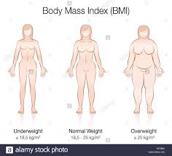
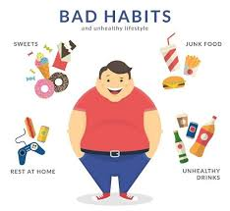
Background Problem
People living unhealthy life
Unbalance diet
Lack of exercise
etc
Picture 1: Human body
Picture 2: Obesity

Slide 3

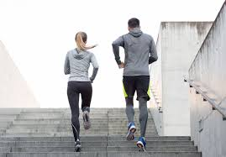
Solution
Personal Gym Trainer allows user to analyse their health from their daily routine, height, weight, and diet.
Personal Gym Trainer also make the users a exercise schedule and daily diet menu.
Picture 4: Jogging
Picture 5: Push-ups

Slide 4
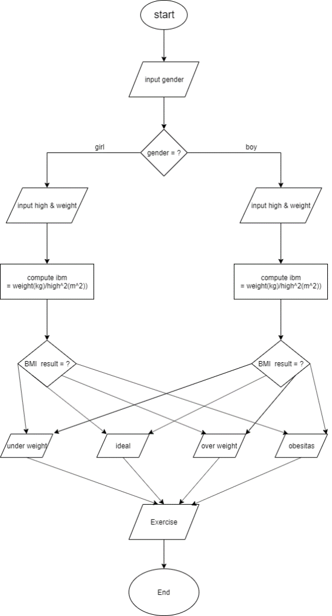
Flowchart
As shown in the flowchart:
First retreave the the data
Is it male or female?
Calculate the given height and weight
Output the result according to BMI data
Send Exercise and diet according to data

Slide 5
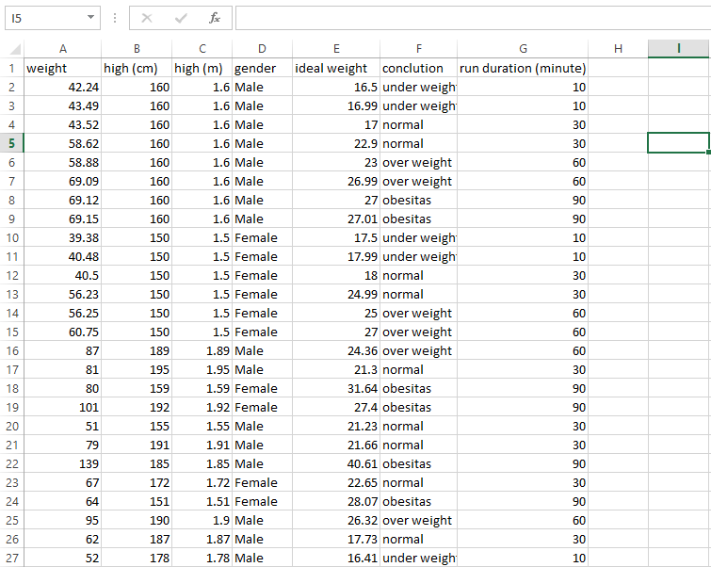
Sample Data

Slide 6
Hasil + Screenshot

Slide 7
Rencana Pengembangan Selanjutnya
For next improvement, There will be more exercise data, and sleep schedule.

Slide 8
Team
Created by BASE.AI:
Edward Wibowo
Lim Kian Phu
Luis Tanuwijaya
Ricky Reynardo

